Slide 1

International Workshop on Optical Perception
Centre for Artificial Intelligence and Machine Learning
School of Science
Geometric Hypergraphs
David Suter
Xidian University , September 2024

Slide 2
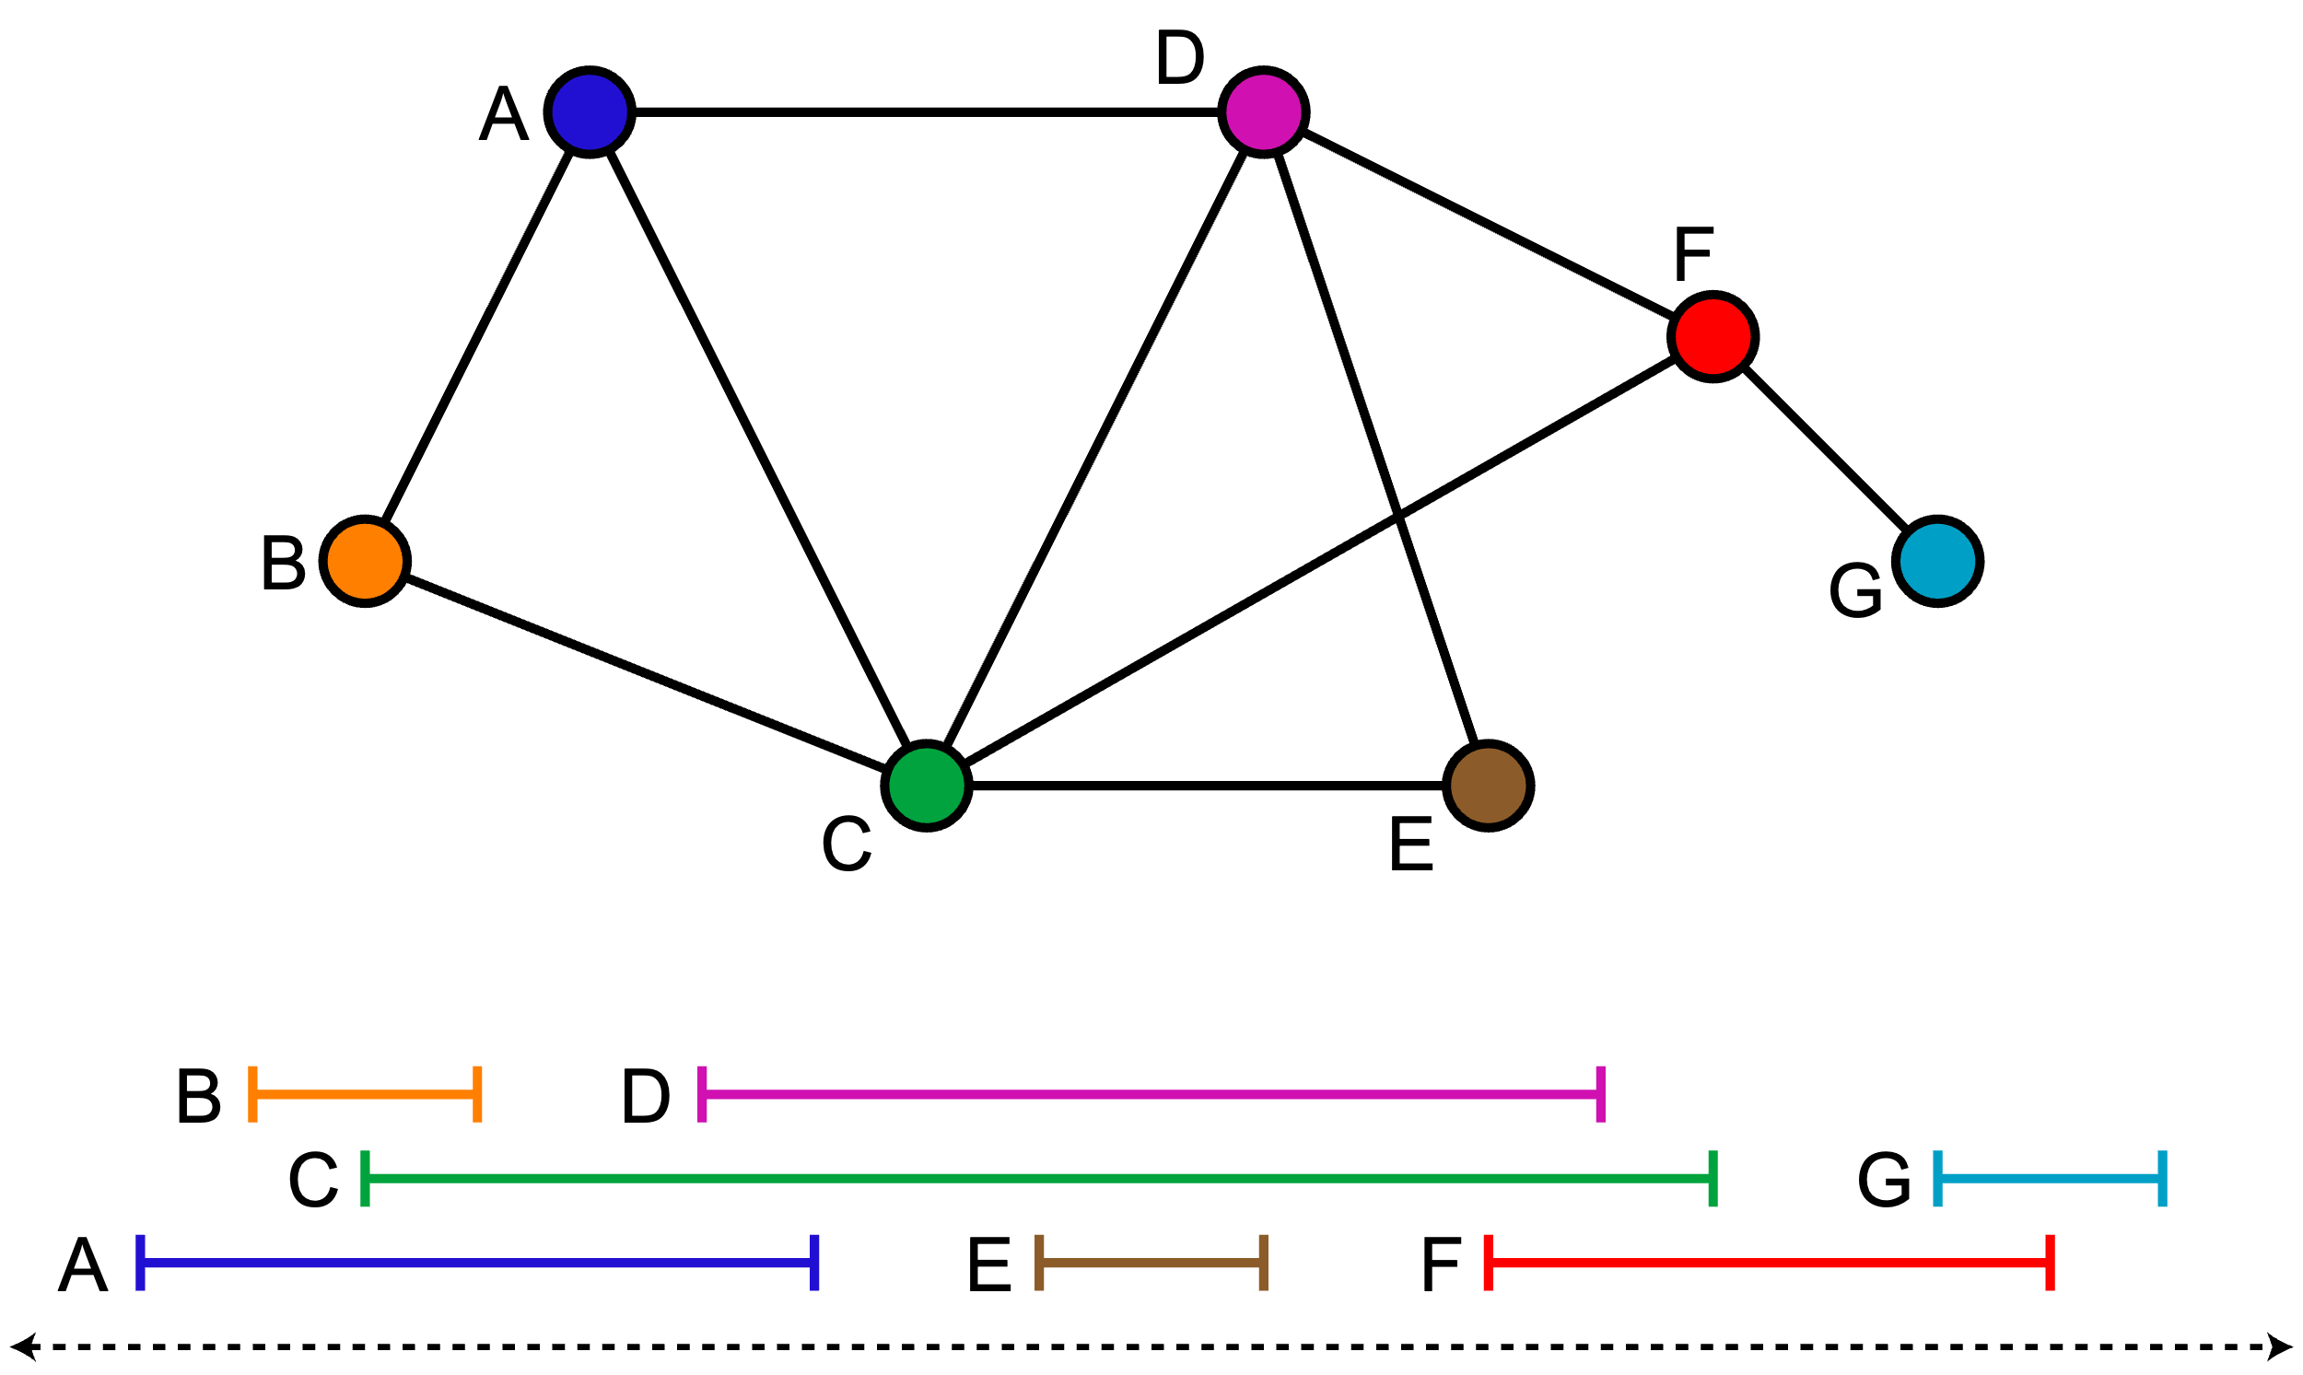
Simple Example – Interval Graphs
Graphs are relationships between PAIRS of items
Hypergraphs are relationships between ANY NUMBER of items
Geometric (Hyper)Graph arise through GEOMETRIC relationships of Items
Perhaps simplest example is an interval graph
Items (vertices in (hyper)graph )
Relationship (pairwise) intersection – “overlap”
Applications – scheduling, and more!
(Image source – wikepedia)

Slide 3
Simple Example – Interval Graphs
Graphs are relationships between PAIRS of items
Hypergraphs are relationships between ANY NUMBER of items
Geometric (Hyper)Graph arise through GEOMETRIC relationships of Items
In scheduling applications – Independent sets (subsets of vertices not containing an edge) represent events that can be scheduled without overlap.
Sometimes overlap is bad (conflicts – classes that cannot be at overlapping times for students) – other times good (allowing for passengers to go from train to train, plane to plane)
(Image source – wikepedia)

Slide 4
Why are Geometric (Hyper)graphs good?
Since they arise (naturally) from real world problems – they are often the underlying “concept” for your problem.
Since they arise from Geometry – they “benefit” for what is known about geometry and the restrictions of certain geometric relationships. E.g. Helly’s theorem – if every (d+1) subset of CONVEX bodies in R^d intersect (overlap) then the whole set of bodies intersect/overlap (have a common point). Intervals are convex. d=1. Helly -> if every PAIR of intervals overlap then so does the whole collection. THAT IS, cliques in the interval graph of size k have to represent not only k intervals that PAIRWISE intersect, but K intervals that have a common point (their intersection collectively is non-empty).
Restrictions are good (though they sound bad ☺). Restrictions “tame the wild”.
The set of possible graphs contains even the worst case graphs (for your algorithms/tasks).
A RESTRICTED subclass of graphs could be good (for your algorithms/problem).
The restriction is a property that not all graphs obey, that property that graphs from YOUR problem obey – could be the thing your algorithm can exploit to run fast.

Slide 5
Generalizing Overlap/Intersection –stabbing etc Universe of Geometric Hypergraphs
Intersection = “stabbable” by points. If sets of points in R^d intersect then they have at least one point in common – there is one point that “stabs” every set.
Generalise – “stabbable” by points -> stabbable by X (X could be lines – having at least one point in common becomes they have a common line that intersects them all)
Intersect <-> at least one point stabs them both
“Stabbable” by a common line
More technical/common terms – transversal/hitting set. Range spaces….etc.

Slide 6
Generalizing Overlap/Intersection –stabbing etc Universe of Geometric Hypergraphs
Note – any PAIR of disks is ALWAYS stabbable by a single line. So that is an “information free”
situation. Information only exists when 3 or more discs are stabble by a line. So this is not a “graph” setting – but a HYPERgraph setting.
Intersect <-> at least one point stabs them both
“Stabbable” by a common line
More technical/common terms – transversal/hitting set. Range spaces….etc.

Slide 7
But what does this have to do with AI, Machine Learning, Signal and Image Processing???
Things I am interested in – computer vision, AI, Machine Learning, Robust Fitting, Signal and Image Processing….
In some sense it is relatively obvious why Geometric Hypergraphs are relevant.
After all – geometry underlies a lot of computer vision (the “geometry of cameras, the visual world etc.”). More abstractly, AI and Machine learning is about processing “features” extracted from the data to do a task. Features are often thought of as vectors in a space and the relationship between features becomes associated with geometric notions in that embedding space.
Indeed – what is clustering? That ubiquitous “engine” of a lot of data analysis, AI, Machine Learning. It is analysing the “associations <-> relationships “ between points in feature space – their closeness to each other in some – often geometric sense/measure.

Slide 8
But what does this have to do with AI, Machine Learning, Signal and Image Processing???
My PRIMARY motivation currently is “robust fitting” (and robust fitting for computer vision).
Robust fitting is essentially like “fitting within tolerances”. Outliers “don’t belong to the fit” because they cannot be fit within tolerance.
Tolerances can be pictured as geometric shapes around the data points. The models must “stab” these geometric shapes to be within tolerance of the data points.

Slide 9
But what does this have to do with AI, Machine Learning, Signal and Image Processing???
My PRIMARY motivation currently is “robust fitting” (and robust fitting for computer vision).
Robust fitting is essentially like “fitting within tolerances”. Outliers “don’t belong to the fit” because they cannot be fit within tolerance.
Tolerances can be pictured as geometric shapes around the data points. The models must “stab” these geometric shapes to be within tolerance of the data points.
Data Points

Slide 10
But what does this have to do with AI, Machine Learning, Signal and Image Processing???
My PRIMARY motivation currently is “robust fitting” (and robust fitting for computer vision).
Robust fitting is essentially like “fitting within tolerances”. Outliers “don’t belong to the fit” because they cannot be fit within tolerance.
Tolerances can be pictured as geometric shapes around the data points. The models must “stab” these geometric shapes to be within tolerance of the data points.
A line that fits 4 points within tolerance – ie., line stabbing disks
Data Points – with tolerances

Slide 11
But what does this have to do with AI, Machine Learning, Signal and Image Processing???
Maximum Consensus Robust fitting (MaxCon) – find the model that fits the most data points within tolerance.
A line that fits 4 points within tolerance – ie., line stabbing disks
Data Points – with tolerances

Slide 12
But what does this have to do with AI, Machine Learning, Signal and Image Processing???
Maximum Consensus Robust fitting (MaxCon) – find the model that fits the most data points within tolerance.
But of course I am interested in problems more complex than fitting points (in 2D) to lines.
Models that relate camera positions, point cloud registrations, image stitching transformations, etc.
A line that fits 4 points within tolerance – ie., line stabbing disks
Data Points – with tolerances

Slide 13
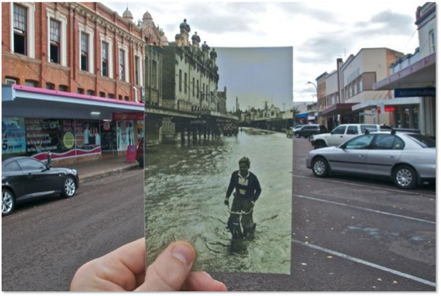
But what does this have to do with AI, Machine Learning, Signal and Image Processing???
Image 1 (x,y,1) <-> Image 2 (x’,y’,1)
(x’,y’,w)^T=H(x,y,1)^T
H – 3x3 homography matrix
(image stitching)
Other “models” R,t (point cloud aignment)
F (3x3 matrix relating geometry of stereo vision)
Etc.
(Permission to use photo via Daniel Barath)

Slide 14
But what does this have to do with AI, Machine Learning, Signal and Image Processing???
In fact, much of Machine Learning and related areas is essentially the geometry of “feature space”.
e.g., image –> thousands of features (thought of as vectors in R^{n} ). Then the task is reduced to something like clustering, linear separation (classifier) etc.
In fact, the most often hypergraph referred to as a geometric hypergraph is the one where edges are
defined by proximity – spheres in feature space.

Slide 15
But what does this have to do with AI, Machine Learning, Signal and Image Processing???
Clustering then is finding large cliques in a such a geometric hypergraph.
Many applications – community detection (social networks), preferences (commerce), etc etc

Slide 16
Structure and complexity in hypergraphs
Cliques are perhaps the most obvious type of structure in hypergraphs (and of course, therefore their complement – independent (stable) sets.
Thus, the number of cliques and their sizes is one important measure of structure/complexity.
More generally (hyper)graph classes capture a variety of “complexities”/structure.

Slide 17
Example (robust) line fitting
Data with no outliers – the simplest situation.
(hyper)Graph is just one single clique (and complement (graph)hypergraph is a set of isolated vertices – one single independent set.
A line that fits 4 points within tolerance – ie., line stabbing disks
In graph theory denoted K_{n}
Data Points – with tolerances

Slide 18
Example (robust) line fitting
Next most simple – one clique and isolated vertices (one “structure” and “pure” outliers)
A line that fits 4 points within tolerance – ie., line stabbing disks
Data Points – with tolerances

Slide 19
Complexity charcterization
Clique – “level 0 compolexity”

Slide 20
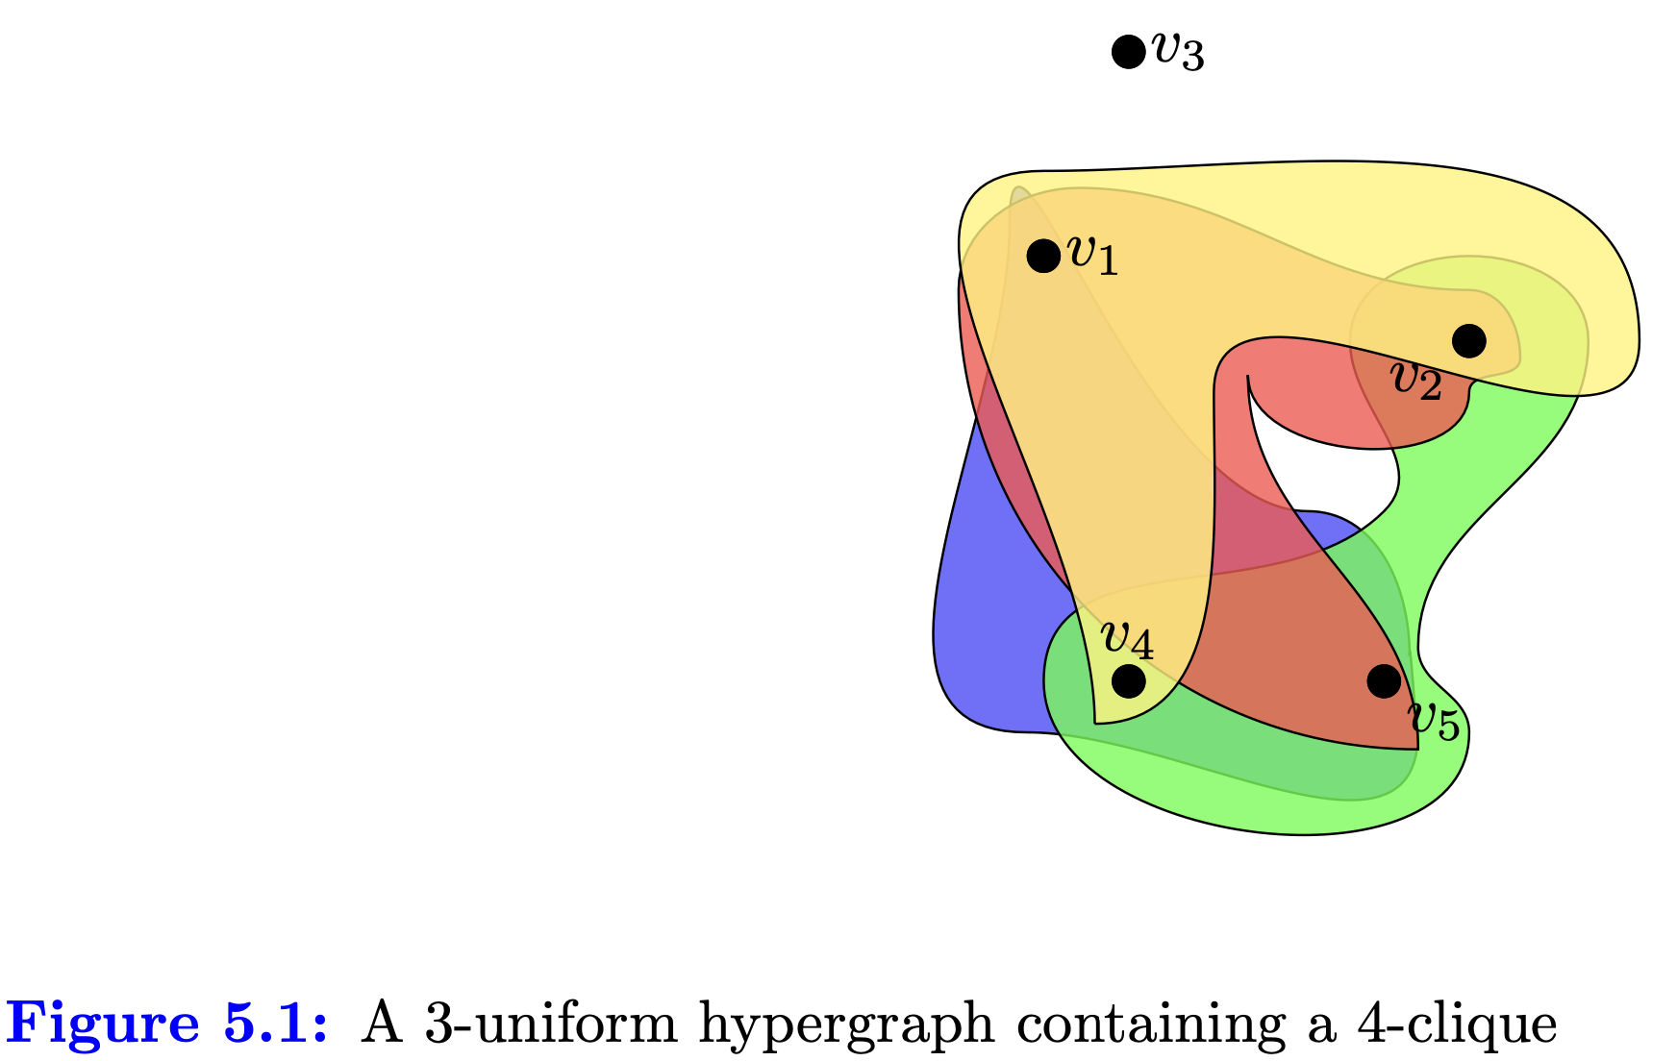
Complexity charcterization
Clique with isolated vertices – “level 1 complexity”

Slide 21
Complexity charcterization
Clique with set of independent vertices and some edges between – “level 2 complexity”
K:S aka “Split Graph”

Slide 22
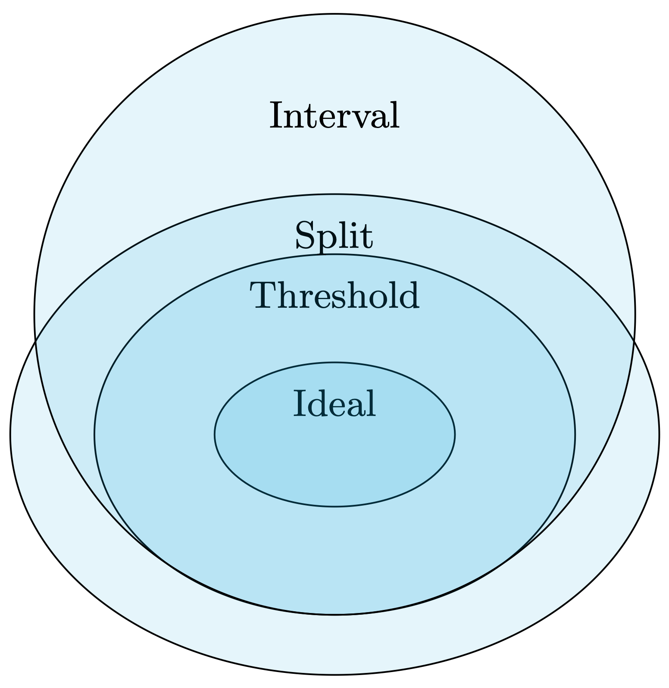
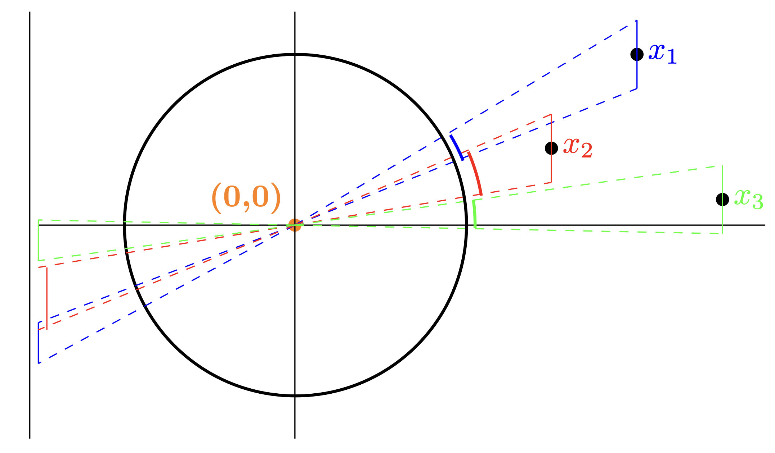
Complexity characterization – robust linear subspace in 2D (line) regression

Slide 23
Complexity characterization – robust linear subspace in 2D (line) regression
Graph
Hypergraph
1D location,
1D subspace in 2D
(affine) line fitting in 2D,
Homography fitting, Fundamental Matrix fitting, Rigid Motion fitting…..
?
K:S

Slide 24
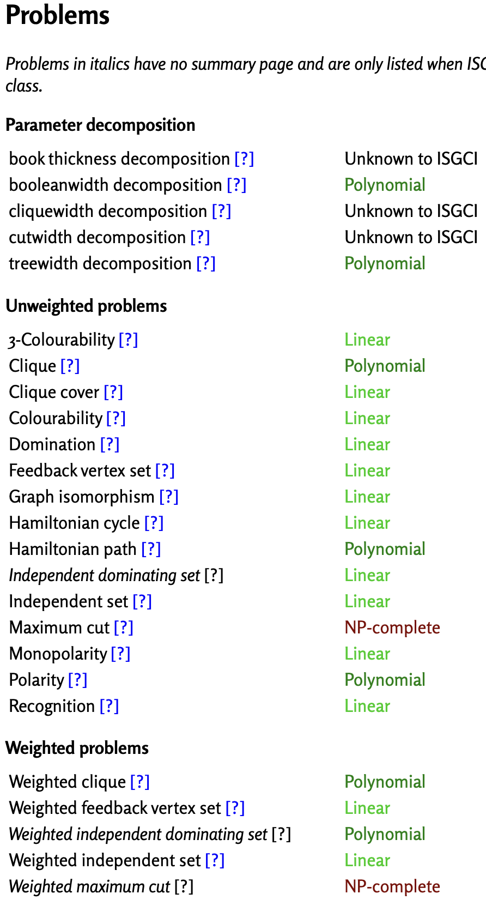
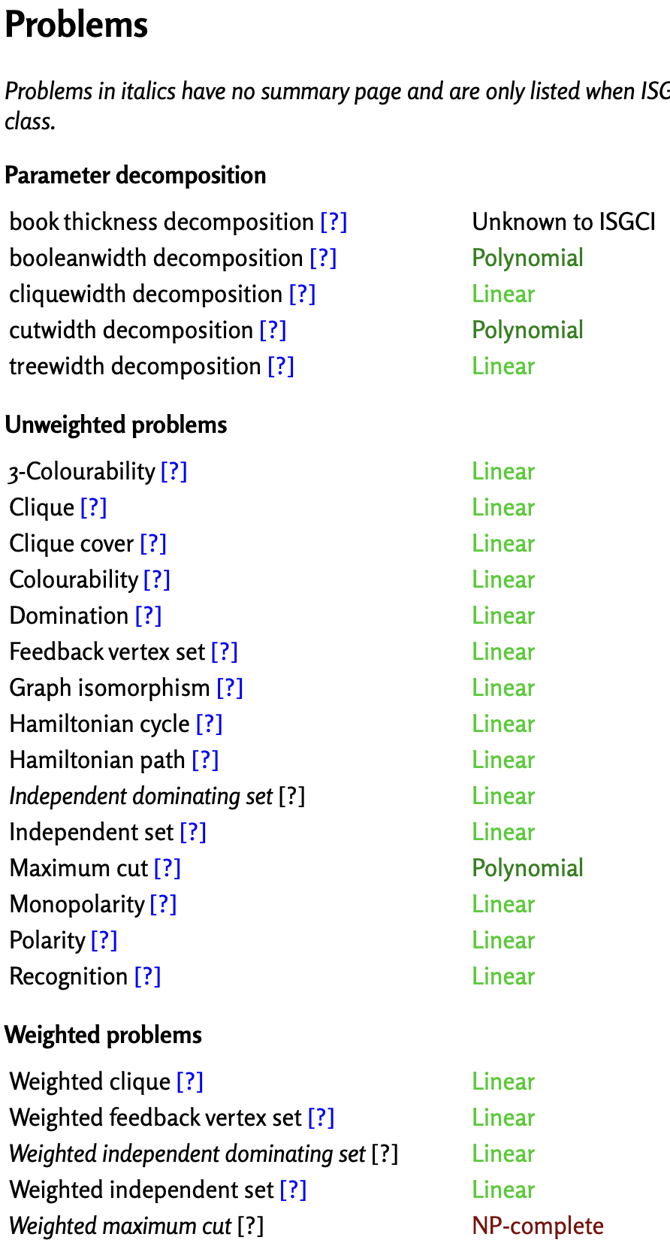
Complexity characterization – why does this matter?
Interval Class
Threshold Class
Ideal Class (K:S)
Many problems trivial – any greedy algorithm finds max clique, max independent set…
“Totally” Ideal Class (K)
No algorithm needed!!!
No robust fitting
needed...

Slide 25
Complexity charcterization
The “full story” is much more rich and complicated…
graphclasses.org
(for hypergraphs much less is documented/known –
There is a beta “geometric hypergraph zoo page” but for a very small part of the hypergraph zoo…)
Much less is known (yet) about geometric hypergraphs – and a class taxonomy

Slide 26
Only a peak into the whole story…..
This area is an interesting (and still being discovered) story at the intersection of combinatorics, discrete/computational maths, discrete topology, theoretical computer science, Boolean function theory, etc.
I’ve only been able to give a “taste/glimpse” of both the area and my interests in application to robust fitting.

Slide 27
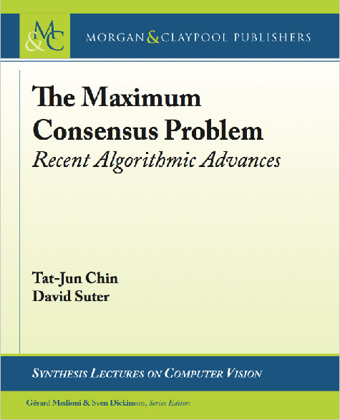
Some of this material will be in 2nd edition……
Related publications:
Giang Truong, Huu Le, Erchuan Zhang, David Suter, and Syed Zulqarnain Gilani. “Unsupervised Learning for Max- imum Consensus Robust Fitting: A Reinforcement Learning Approach”. In: IEEE Transactions on Pattern Analysis and Machine Intelligence 45.3 (2023), pp. 3890–3903. doi: 10.1109/TPAMI.2022.3178442.
Erchaun Zhang, David Suter, Ruwan Tennakoon, Tat-Jun Chin, Alireza Bab-Hadiashar, Giang Truong, and Syed Zulqarnain Gilani. “Maximum Consensus by Weighted Influences of Monotone Boolean Functions”. In: 2022 IEEE/CVF Conference on Computer Vision and Pattern Recognition (CVPR). 2022, pp. 8954–8962. doi: 10.1109/CVPR52688. 2022.00876.
Tat-Jun Chin, David Suter, Shin-Fang Ch’ng, and James Quach. “Quantum Robust Fitting”. In: Computer Vision – ACCV 2020. Ed. by Hiroshi Ishikawa, Cheng-Lin Liu, Tomas Pajdla, and Jianbo Shi. Cham: Springer International Publishing, 2021, pp. 485–499. isbn: 978-3-030-69525-5. doi: 10.1007/978-3-030-69525-5_29.
Ruwan Tennakoon, David Suter, Erchuan Zhang, Tat-Jun Chin, and Alireza Bab-Hadiashar. “Consensus Maximisation Using Influences of Monotone Boolean Functions”. In: 2021 IEEE/CVF Conference on Computer Vision and Pattern Recognition (CVPR). Oral Presentation (17% of accepted papers, roughly 3% of sumitted papers). 2021, pp. 2865– 2874. doi: 10.1109/CVPR46437.2021.00289.
Robust Fitting on a Gate Quantum Computer – ECCV2024 to appear – colleagues at UoAdelaide
1st ed 2017
2nd ed under contract

Slide 28


“Geometric Hypergraphs” – they are everywhere

Slide 30
Dilworth number of graph
Maximum number of chains (of vicinal order) necessary to cover the graph…
Threshold graphs are Dilworth1

Slide 31
Permutation graph
Permutation includes cograph which includes threshold

